Slide 1
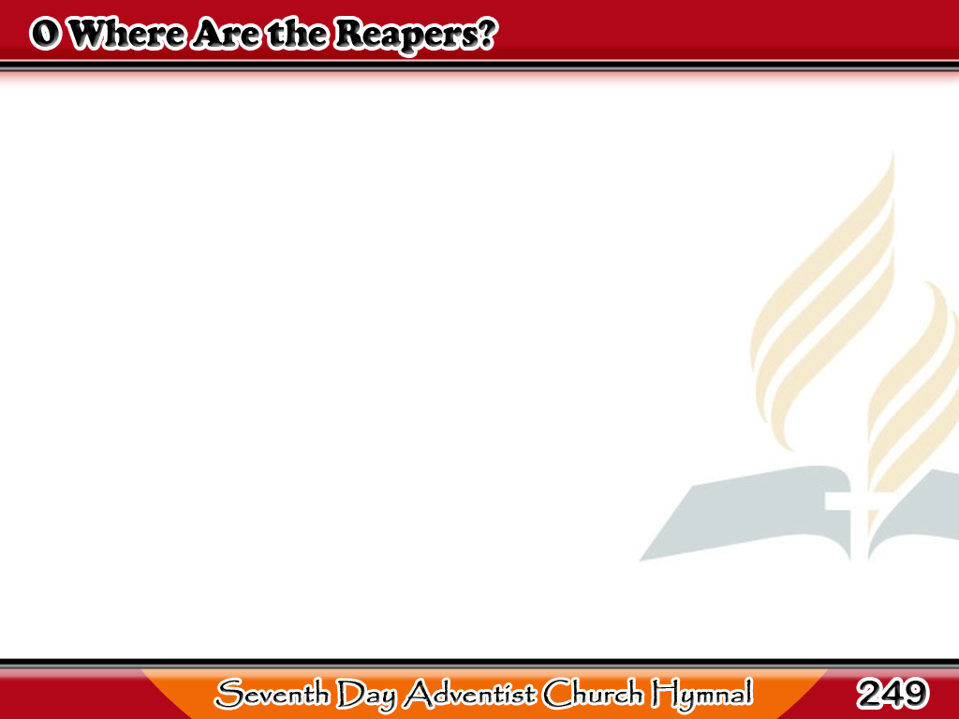
Mga Manggagapas ay Nasaan?
O where are the reapers
that garner in
The sheaves of the good
from the fields of sin?
1/3

Slide 2
Mga Manggagapas ay Nasaan?
With sickles of truth
must the work be done,
And no one may rest till the
“harvest home.”
1/3

Slide 3
Mga Manggagapas ay Nasaan?
-Refrain-
Where are the reapers?
O who will come
And share in the glory of the
“harvest home”?
1/3

Slide 4
Mga Manggagapas ay Nasaan?
-Refrain-
O who will help us
to garner in
The sheaves of good
from the fields of sin?
1/3

Slide 5
Mga Manggagapas ay Nasaan?
The fields all are ripening,
and far and wide
The world now is waiting
the harvest tide:
2/3

Slide 6
Mga Manggagapas ay Nasaan?
But reapers are few,
and the work is great,
And much will be lost
should the harvest wait.
2/3

Slide 7
Mga Manggagapas ay Nasaan?
-Refrain-
Where are the reapers?
O who will come
And share in the glory of the
“harvest home”?
2/3

Slide 8
Mga Manggagapas ay Nasaan?
-Refrain-
O who will help us
to garner in
The sheaves of good
from the fields of sin?
2/3

Slide 9
Mga Manggagapas ay Nasaan?
So come with your sickles,
ye sons of men,
And gather together
the golden grain;
3/3

Slide 10
Mga Manggagapas ay Nasaan?
Toil on till the Lord
of the harvest come,
Then share ye His joy
in the “harvest home.”
3/3

Slide 11
Mga Manggagapas ay Nasaan?
-Refrain-
Where are the reapers?
O who will come
And share in the glory of the
“harvest home”?
3/3

Slide 12
Mga Manggagapas ay Nasaan?
-Refrain-
O who will help us
to garner in
The sheaves of good
from the fields of sin?
3/3

